Slide 1
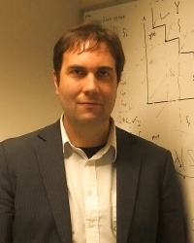


Multicriteria Optimization and Decision Analysis (MODA)
Lecturer: Michael Emmerich
(Associate Professor, LIACS)
TAs: Yali Wang, Hui Wang
Master CS, 4 ECT
11x1.5h Lectures, incl. 2 Exercise Lectures
(blackboard)
MODA Research Group: http://moda.liacs.nl
Notes:
Welcome to the class of MODA
My name is Michael Emmerich
I work as an associate professor in LIACS
My background is computer science, applied mathematics, and chemical engineering
I worked for the German chemical industry and in the Universities of Aken, Dortmund, Lisbon, Amsterdam, Princeton, and Leiden
Currently I am leading the MODA research group.

Slide 2
Learning goals – Introduction Unit
What is multicriteria optimization and decision analysis?
Structure of the course & requirements
How has this field developed? What were major historical steps?
Examples of multicriteria optimization problems. What are criteria, search space, and constraints?

Slide 3
TOPIC of MODA

Slide 4

Example 1: Alternative routes
HAARLEM
AMSTERDAM
SCHIPHOL
AMERSFOORT
Time
Comfort
Price
Min
Max
Min
UTRECHT
LEIDEN
GOUDA
DEN HAAG
Time
ROTTERDAM
TICKET | T | C | P
OPT1 | 3:00 H | 2 | 60 EUR
OPT2 | 3:00 H | 1 | 65 EUR
OPT3 | 3:30 H | 3 | 44 EUR
OPT4 | 4:30 H | 2 | 41 EUR
OPT5 | 15:30 | 4 | 35 EUR
OPT6 | 15:34 | 4 | 32 EUR
Optimal Set
Impossible solutions
Price
O(N!) different paths from Amsterdam to Rotterdam
Notes:
My topic is the new field of Set-oriented Optimization. Let me start with two examples of Set-Oriented Optimization. In order to come from Leiden to Brussel. I had to find a good train connection. Good with respect to multiple criteria. Speed, Comfort (changes), Price.
The set of possible routes is astronomically large, but still wanted to look at some alternatives. A set oriented optimization, would now output a set of interesting options, interesting with respect to different criteria --- plus compromise solutions.

Slide 5
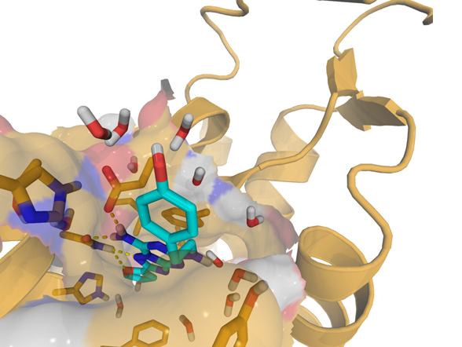
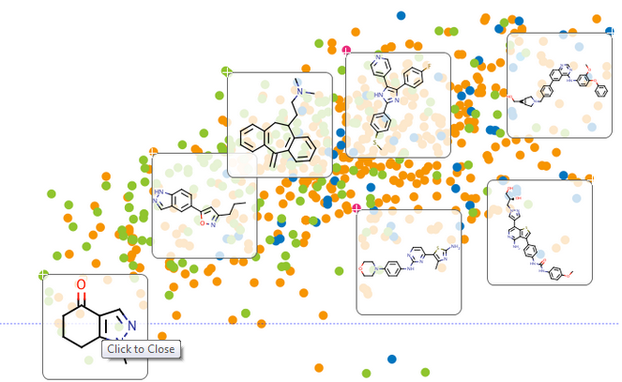
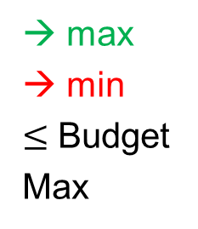
Example 2: In-Silico Drug Discovery
→ max
→ min
$≤$ Budget
Max
Activity
Side-effects
Cost
Diversity
10⁶⁰
Universiteit Leiden
Data-Driven Drug Discovery Network (D4N) - Leiden University
Notes:
Second example: In drug discovery chemists look for substances that are effective in curing a disease. These molecules should also have minimal side-effects and be affordable by people. --- The space of all possible drug molecules is nowadays estimated to have a size of 10 to the power of 60. Computer models can be used to estimate criteria. Laboratory tests however can only be applied to a limited set of drug candidates. Set oriented optimization would seek to find a small subset of promising alternative molecules for subsequent evaluation. Again: We have a large search space, general goals, and and to extract a small but diverse set of alternative solutions.

Slide 6
Multicriteria Optimization and Decision Analysis
Definition: Multicriteria Decision Analysis (MCDA) is a scientific field that studies evaluation of a finite number of alternatives based on multiple criteria. It provides systematic methods to compare, evaluate, and rank solutions.
Definition: Multicriteria Optimization (MCO) is a scientific field that studies search for optimal solutions given multiple criteria and constraints. Here, usually, the search space is very large and not all solutions can be inspected (e.g., scheduling, design, control)
Definition: Multiobjective Decision Making (MCDM) deals with MCDA and MCO or combinations of these.
We use here the title: ”Multicriteria Optimization and Decision Analysis = MODA” instead of MCDM in order to focus more on the algorithmically challenging optimization/operational research aspect.

Slide 7


Multi-parametric Complexity in Multicriteria Decision Analysis
Number of variables/search space size $n$
Number of objective functions $m$
Number of constraint functions $r$
Number of retrieved alternative solutions $s$
Number of decision makers $d$
Degree of (non-)linearity $l$ (linear, quadratic, etc.)
$⇒$ Multi-parametric problem complexity $Θ\left(n,m, r, s, d,l\right)$

Slide 8
Class Contents
Day 01 Linear and Nonlinear Programming (Single Objective)
Day 02 Multicriteria Decision Optimization and Decision Analysis
Day 03 Design Optimization I
Day 04 Design Optimization II
Day 05 Data-driven and Interactive Optimization + Quiz
Literature:
Slides, Exercises & Solutions

Slide 9


Homework
Homework assignments, testing:
Part 1: Practical project report (4-6pages, design optimization), will include some programming/scripting in python
Part 2: Online Quiz (Friday) – some theory questions on concepts in class (pass: $≥ 55\%$ correct)
Grades: attended (certificate), passed (4ECT + certificate), passed with excellence (4ECT + certificate)

Slide 10
Historical Remarks

Slide 11
Early roots of MCDA
A very early reference relating to Multiple Criteria Decision Analysis algorithms can be traced to Benjamin Franklin* (1706 1790)
He allegedly had a simple paper system for deciding important issues.
Take a sheet of paper.
On one side, write the arguments in favor of a decision;
on the other side, write the arguments against.
Strike out arguments on each side of the paper that are relatively of equal importance.
When all the arguments on one side are struck out, the side which has the remaining arguments is the side of the argument that should be supported.
Supposedly Franklin used this in making important decisions.
*Benjamin Franklin,
polymath and
founding father of USA
1706 – 1790
Source: http://www.mcdmsociety.org/facts.html

Slide 12
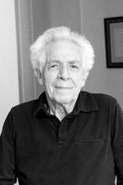
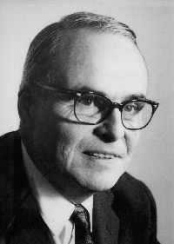
Development
Vilfredo Pareto (1848–1923), an Italian economist who used the concept of Pareto efficiency in his studies of economic efficiency and income distribution:
At the same time Francis Edgeworth defined ‘indifference curves’, the ‘core’ of an exchange economy, and the so-called ‘Edgeworth box’ based on a concept of local Pareto optimality for two criteria.
When Kuhn and Tucker formulated optimality conditions for nonlinear optimization with constraints in 1951, they also considered problems with multiple objectives.
Harold W. Kuhn
US-American Mathematician
1924-2014
Albert William Tucker
Canadian Mathematician,
1905-1995
Vilfredo Pareto,
Italian economist,
1848-1923
Francis Edgeworth,
British Economist,
Around 1900
1951

Slide 13
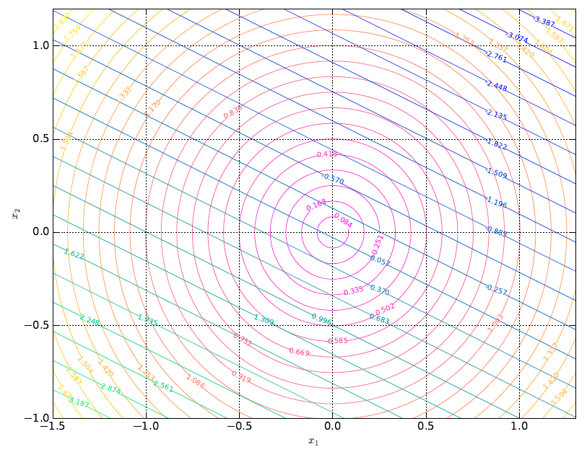




${ g}_{1}\left(x,y\right)$ infeasible
${ g}_{2}\left(x_{1},x_{2}\right)$ infeasible
$${ g}_{1}\left(x_{1},x_{2}\right)≡0$$
$${ g}_{2}\left(x_{1},x_{2}\right)≡0$$

Slide 14
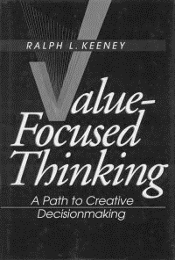
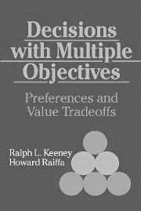
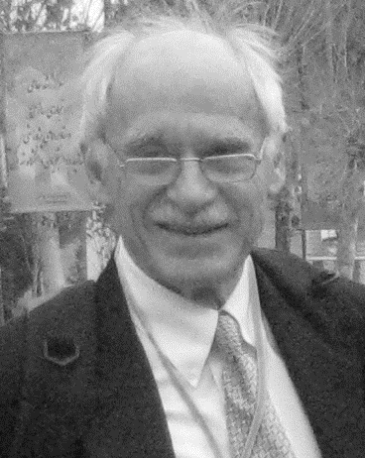
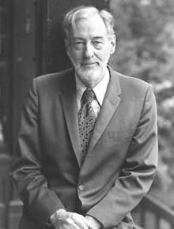
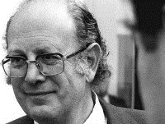
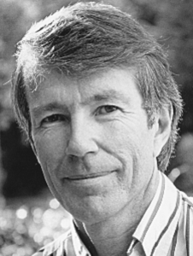
Development
Ralph Keeney and Howard Raiffa published an important work in 1976. This book was instrumental in establishing the theory of multiattribute value theory (including utility theory) as a discipline. It became a standard reference and text for many generations of study of decision analysis and MCDM.
Ralph Steuer's professor, John Evans, suggested the topic of developing a multiple criteria simplex method to compute all efficient extreme points. Inspiration was drawn from earlier works of Karlin, Koopmans, and Geoffrion. Steuers ADBASE computer code for generating efficient points became important. (1986)
Ralph Steuer,
US American Economist
Howard Raiffa
*1924
US American
Economist
Ralph Keeney
US American
Decision Analyst
Tjalling Koopmans
1910-1985
Dutch
Mathematician
And Nobel Prize
(economics) winner

Slide 15
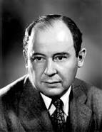
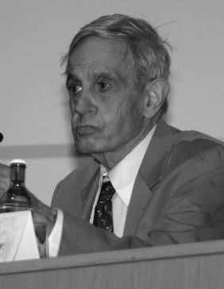
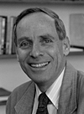
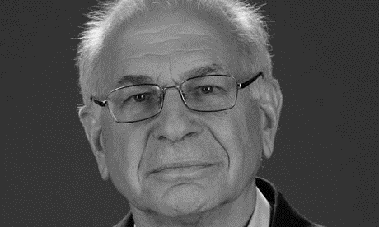
Development
Kahnemann and Tversky studied the psychological aspects of decision making and pointed out (seemingly) irrational components in human decision making.
In the closely related field of game theory, John von Neumann and later John Nash studied decisions in games with conflicting parties.
Remark: Today, multiobjective game theory, is a topic at the intersection of MODA and game theory
John von
Neuman,
US -American Mathematican
(1903-1957)
John Nash,
US -American Mathematican
(*1928)
Nobel Price Economics
Daniel Kahneman (u,*1934-) & Amos Tversky (l,1937-1996), Israeli socio-psychologists, Nobel Price L
© Los Alamos Lab.
https://www.lanl.gov/resources/web-policies/copyright-legal.php
Source: wikipedia

Slide 16


Development
Kaisa Miettinen published a book on Nonlinear Multiobjective Optimization (first edition 1999) which became a standard reference on deterministic methods for solving mathematical programming with multiple criteria.
Kalyanmoy Deb published a seminal book on Evolutionary Multicriteria Optimization (EMO), including NSGA-II algorithm. The work on NSGA-II became the most cited computer science paper 2000-2010.
Since then EMO is a very active field of research, not only in economics but also in (computer) science and engineering.
Recently, new term “Many-objective optimization” for problems with >> 3 objectives, e.g. urban planning, multidisciplinary design.
Kaisa Miettinen,
Finnish Professor for
Industrial Optimization
President of MCDM
Society
Kalyanmoy Deb,
Indian Engineer
& Computer
Scientist
Endowed
Koening Chair,
MSU Michigan

Slide 17
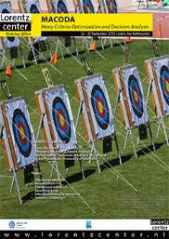
Recent advances: Lorentz Center Workshops: SIMCO 2013, SAMCO 2016, MACODA 2019
Indicator-based MCO
~ Using Statistical Progress Measures
Surrogate-Model Assisted MCO
~ Costly Evaluations (Simulators)

Slide 18
Take home messages
The fields of multicriteria decision analysis and multicriteria optimization are distinguished by whether a small finite set is considered or search in a large search space.
Multiple parameters influence the problem complexity
The fields evolved in parallel, first in economics/operations research and later for other disciplines, especially engineering. and data science
In machine learning goals are to minimize error rates (false positives, false negatives) & model complexity.
In general, multicriteria optimization problems can be defined by the following components: search space, objectives, constraints

